Slide 1
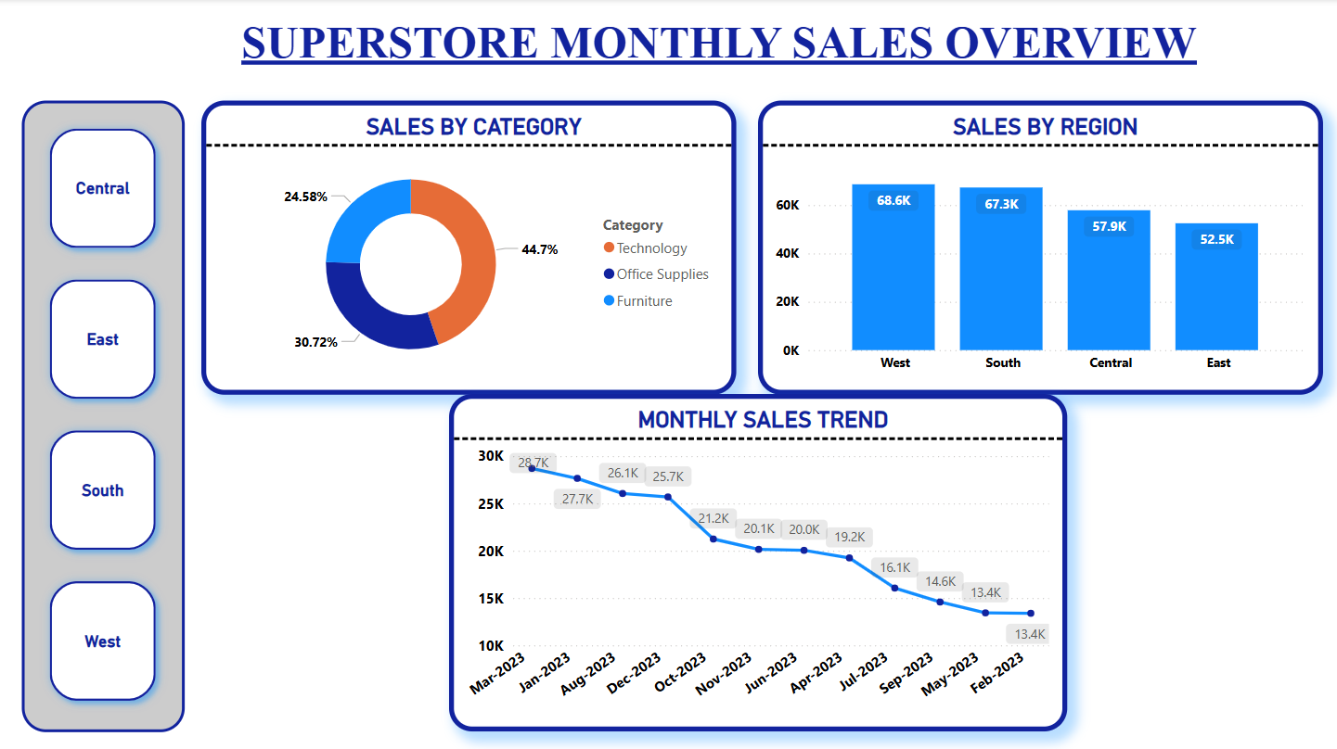
SALES DASHBOARD INSIGHTS
Technology leads in sales by category, contributing 44.7% of total sales, significantly higher than Office Supplies (30.72%) and Furniture (24.58%).
The West region outperformed all others, generating the highest sales at 68.6K, followed closely by the South (67.3K), while the East recorded the lowest at 52.5K.
Sales show a declining trend month-over-month, dropping from a high of 28.7K in March 2023 to 13.4K in February 2024, suggesting a downward momentum or seasonal fluctuation.
August to November 2023 experienced sharper sales drops, indicating a potential area for strategic improvement or promotional intervention.

